Slide 1

Rob Jewett App. Innovation Specialist Global Black Belt
Notes:
Story: build story have dev team and QA teams in different countries (I’ve worked with customers with teams all over the world)
I don’t have a technical background, and I learned this in a few days, and you can do

Slide 2
Getting Started
Log in to https://mobile.azure.com/
Connect directly with Github, your Microsoft login or new sign-up
Add new App → choose OS/platform
Build:
Select a service
Select Branch
Configure and build
Notes:
How many are Objective C developers?
Java?
React?
Xamarin?
How many of you have tried Mobile Center?
I’ll walk you through getting started, and how to get a build set up
Build: is quick and easy to set up,
Doesn't matter what you use to build your app with (Swift, Java, React Native, Xamarin).
Automatically scans your repo and figures everything out for you.
"Poll of the room who can stand up CI in a week? in a day in am hour.
Docs and APIs link in bottom corner

Slide 3
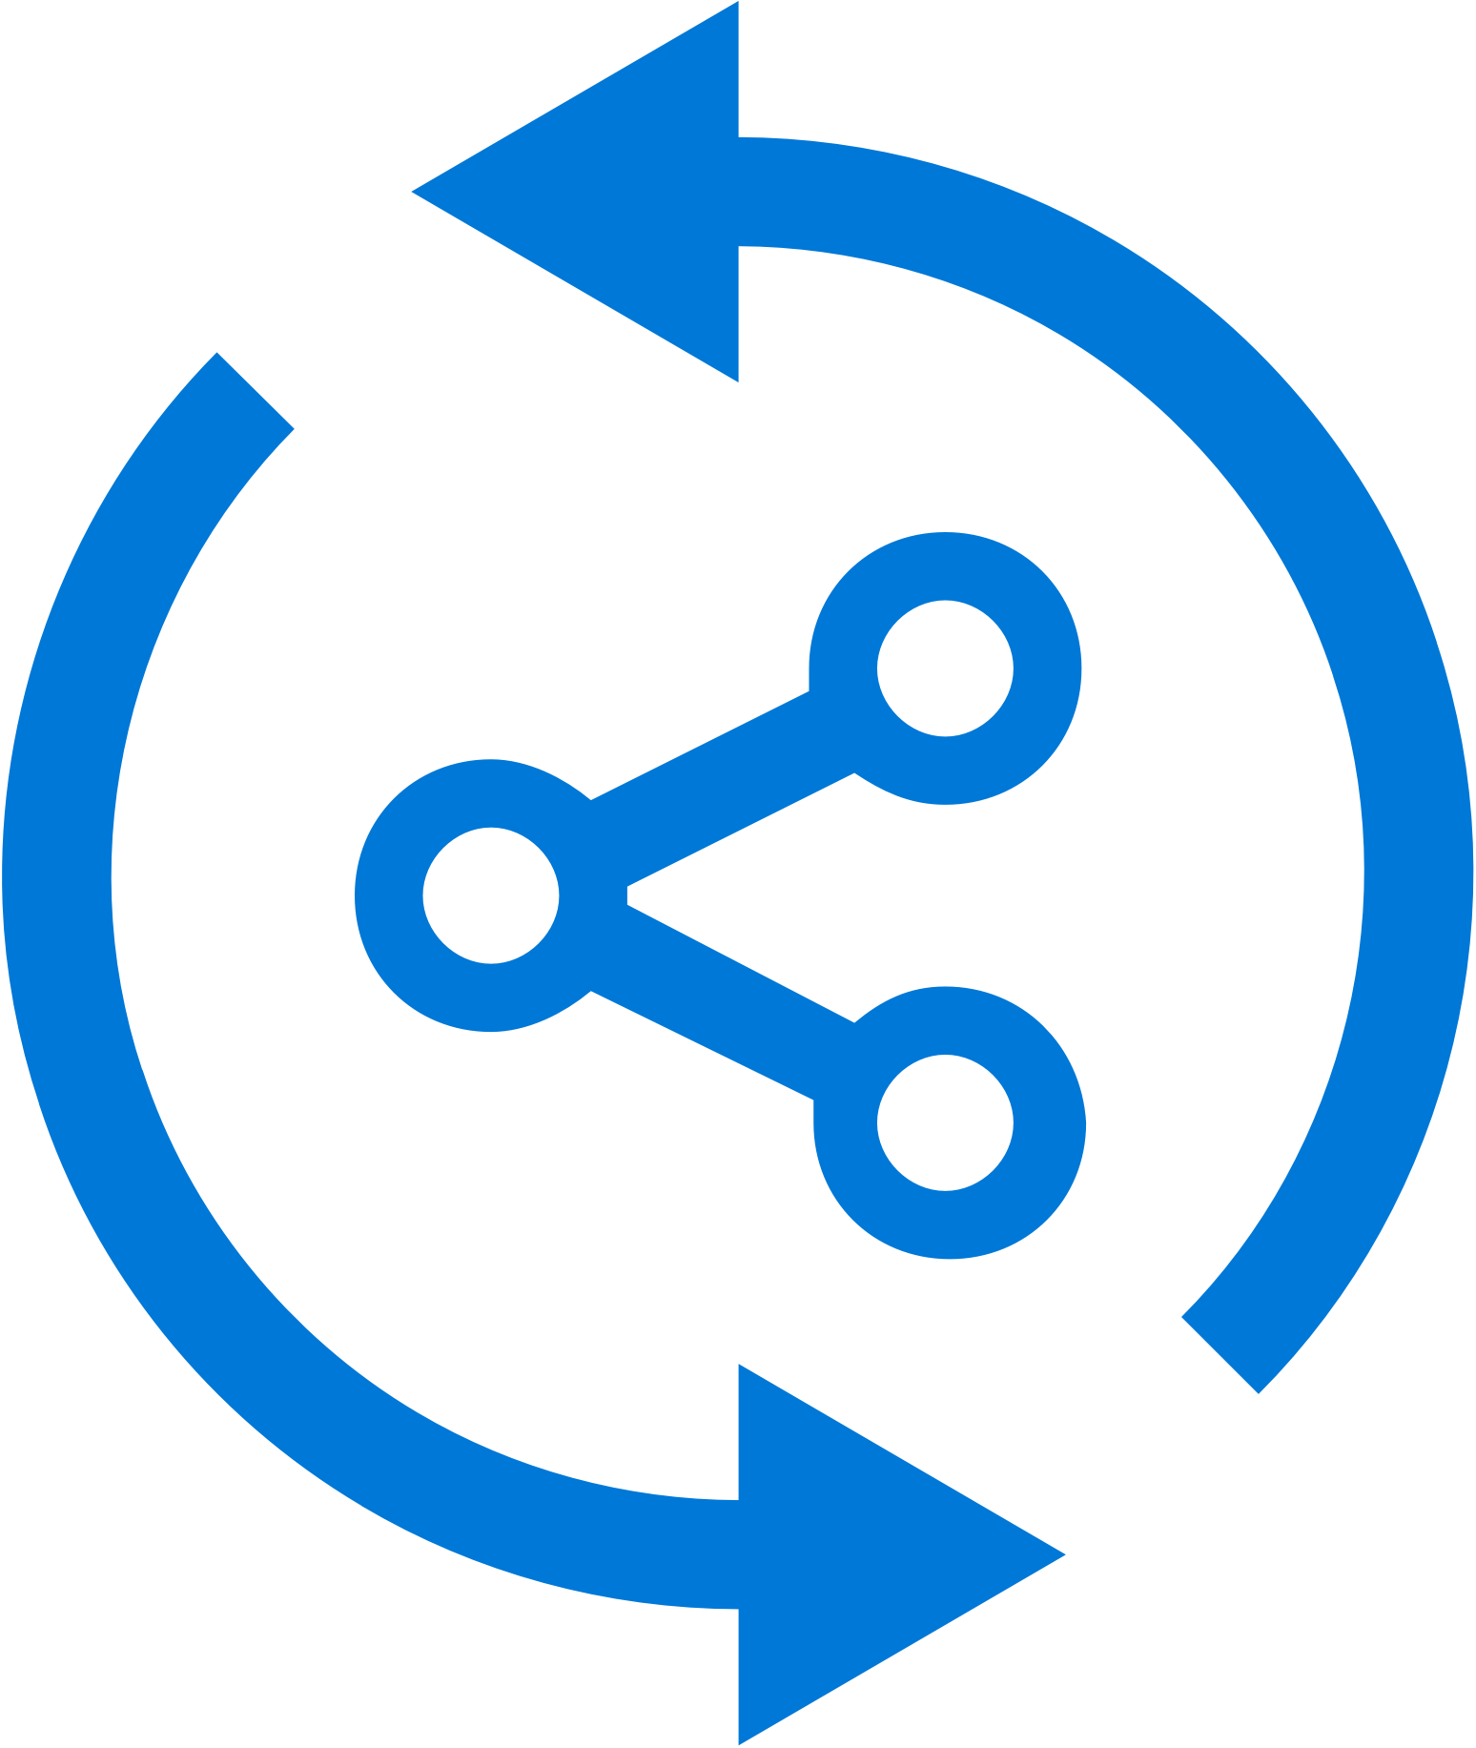


Mobile Center: Build
Build-on-push
With just a few steps automatically build apps with every commit, and generate packages to test and distribute
Work with existing tools
Connect existing repositories in GitHub, Bitbucket, and Visual Studio Team Services with just a few clicks
Build securely in the cloud
Each build is run on a separate, clean virtual machine hosted on our secure cloud servers
Notes:
Each build is run on a separate, clean virtual machine and no other user has access to this virtual machine. Once the build is completed, the virtual machine is discarded and all files removed. The files resulting from the build (log files, application files, symbol files) are stored on Mobile Center servers.

Slide 4
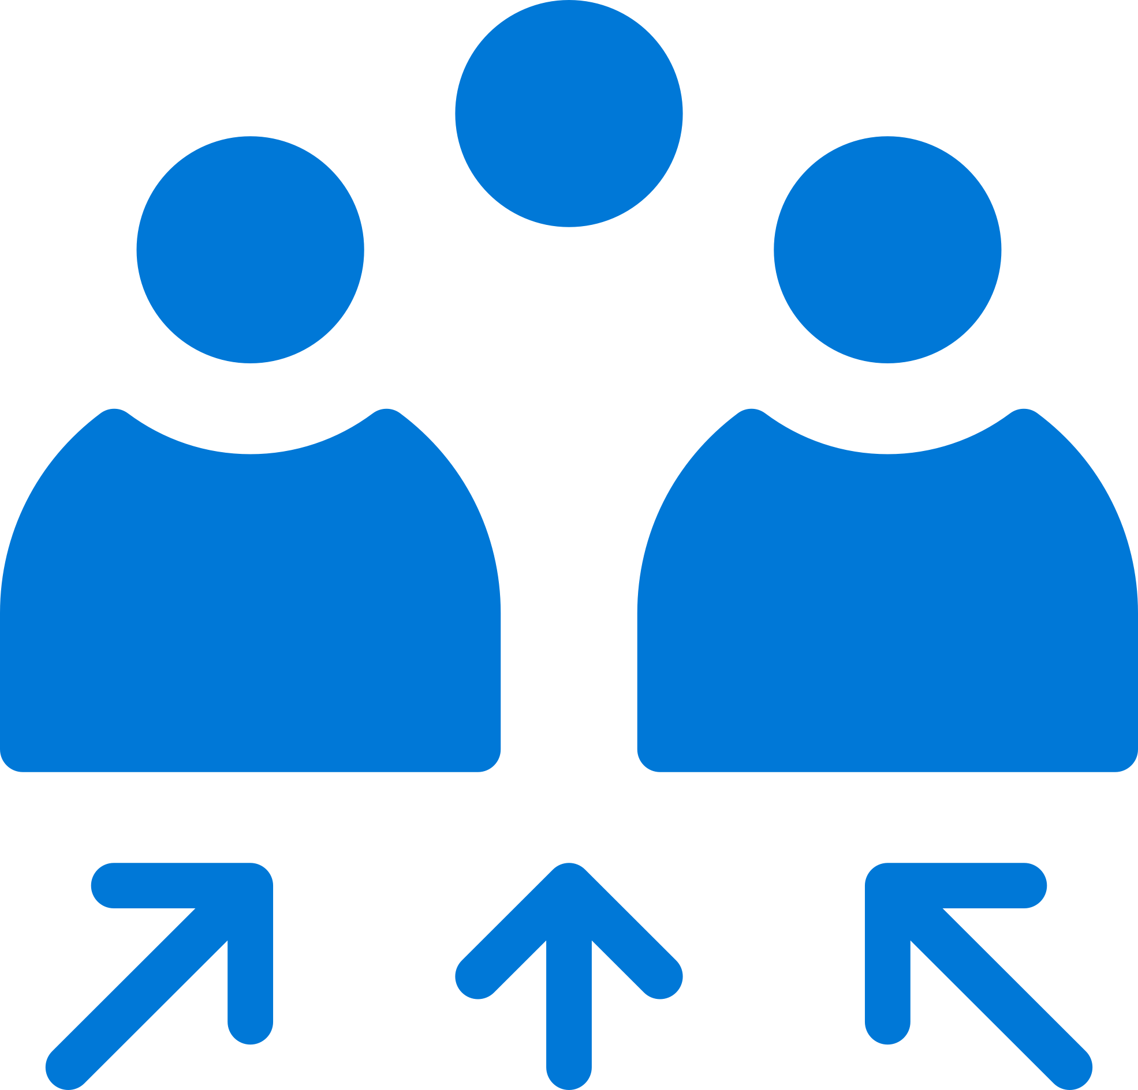
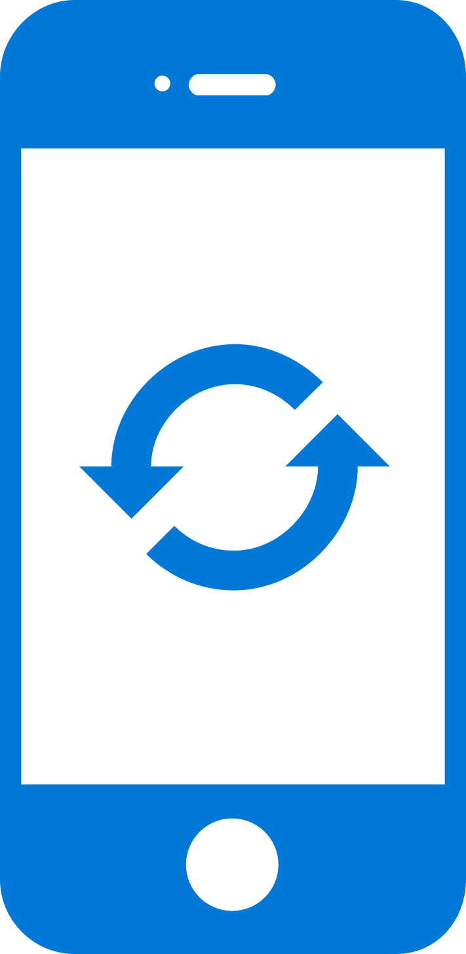

Mobile Center: Push Notifications
Fast and easy to setup
Just a few lines of code in your app. No need to specify format for iOS, Android and Windows.
Send to specific audiences
Target push notifications to specific users or devices
Fast and easy to send
Three easy steps: Compose, Target, and Review.
No need for technical skills!
Notes:
Visual Studio Mobile Center Push Notifications is really easy
-Just a few lines of code in your app
-No need to specify format for Android, iOS or Windows
-and I’ll show you how easy it is to target and send notifications to your users
Difference in Push Notifications between Notification Hub and MC

Slide 5
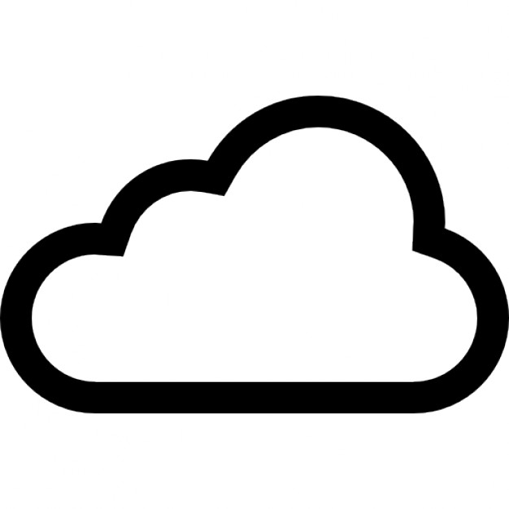

Mobile Center: Push Notifications
push
Push notification services
(Apple and Google)
push
push
Notification
Hubs
Visual Studio
Mobile Center
tokens
Notes:
How many of you are involved in mobile app dev?
How many of your apps have push notifications?
Big point of your mobile apps are to engage user and customers. Push notifications helps do that.

Slide 6
June Cho Enterprise Mobile App Dev App Innovation | Global Black Belt

Slide 7
Why Test on Real Devices?
Verify App Integrity
UI loads as expected on different sized screen
App performs as expected on different CPUs
Accessible UI
Features work as per User Flows
Useable Functionality
Testing as part of CI
Reliable Development Cycle

Slide 8


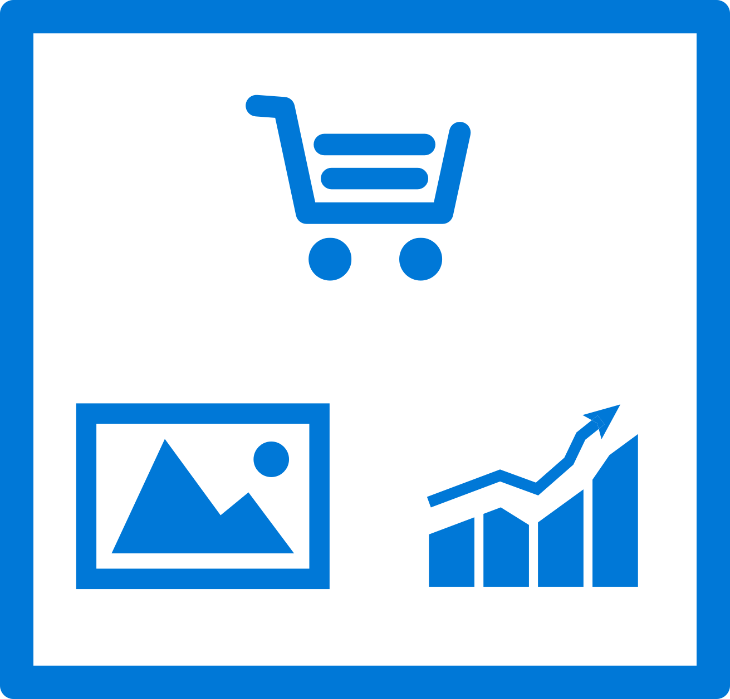
Mobile Center: Test
Release faster
Shrink release times significantly and push new apps out faster
Ship high quality apps Ensure the highest quality user experience that keeps users continuously engaged
Engage a broad audience
Test on a broad range of devices to make sure apps work on your users’ devices
Create new features Spend less time fixing bugs, and more time creating value

Slide 9
Supported Testing Platforms
Xamarin.UITest
Tests written in C#
Supports Xamarin apps, Native (Android, iOS) Apps, React Native Apps, Hybrid Apps
XCUITest
Tests written in Swift
Supports native iOS apps
Espresso
Tests written in Java
Supports native Android apps
Appium
Tests written in Java
Supports native (Android and iOS) apps , Xamarin Apps, React Native Apps, Hybrid Apps

Slide 10
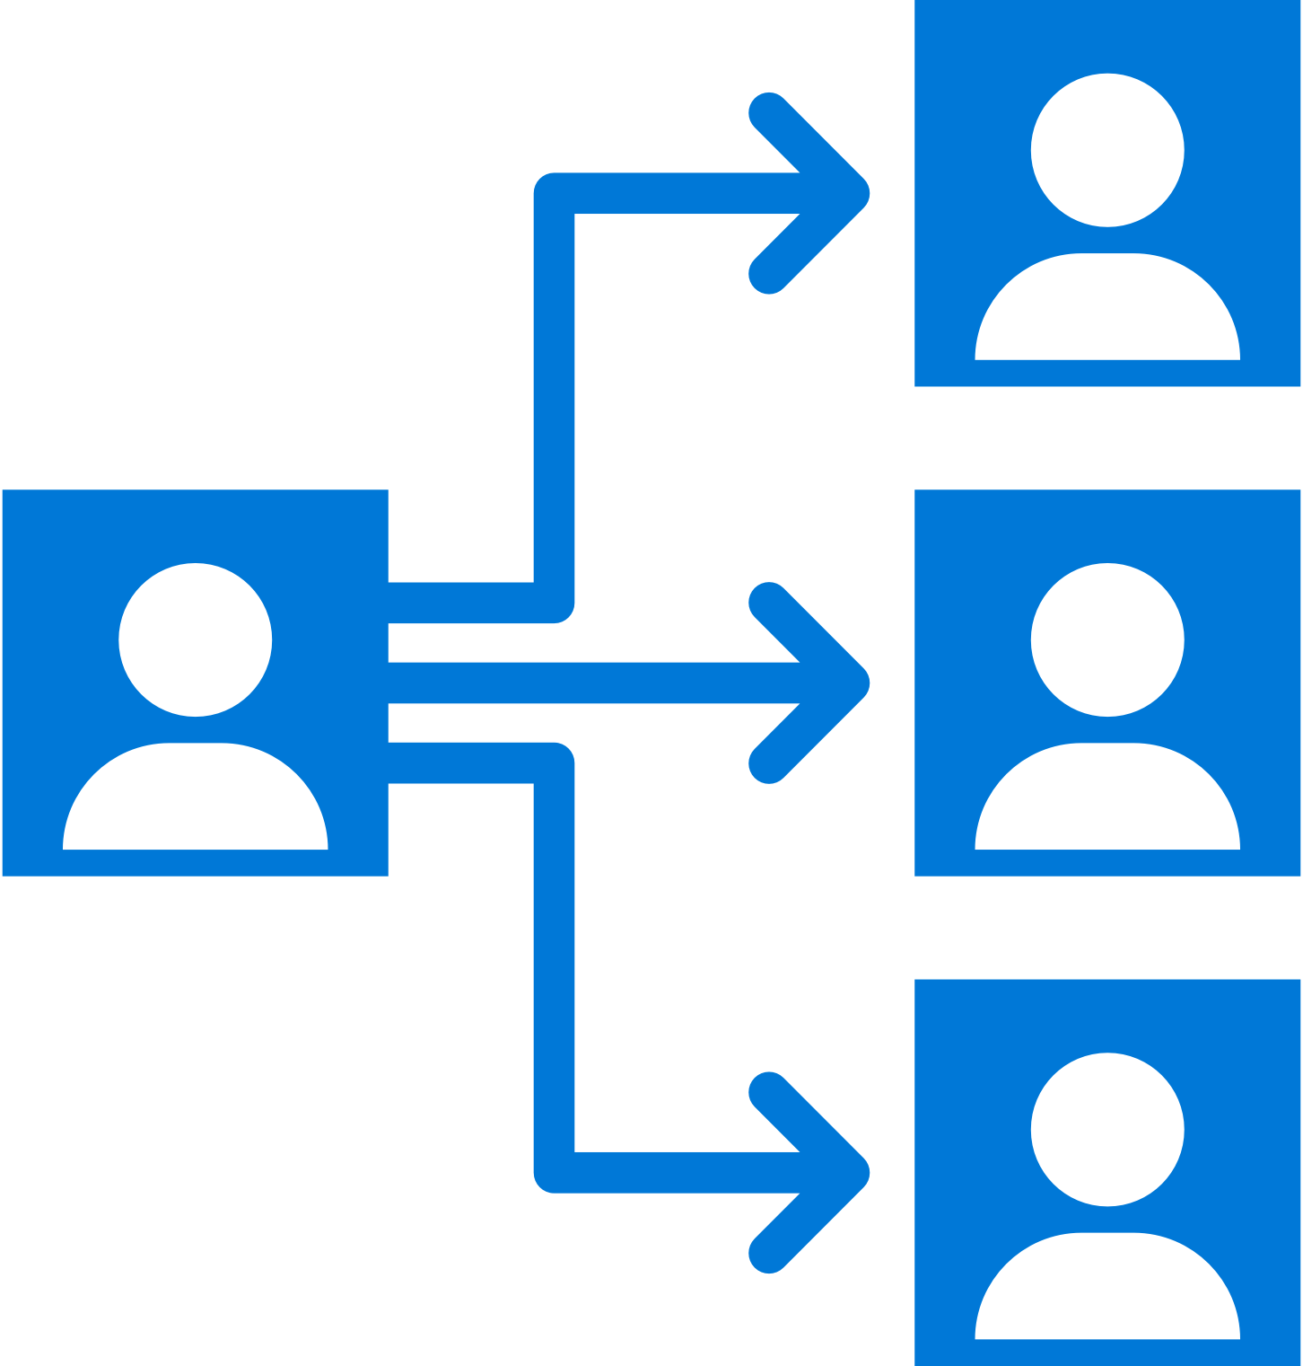
Mobile Center: Distribute
Instantly distribute apps
Quickly get apps in the hands of your beta testers on multiple device platforms
Create targeted distribution groups
With categorized groups of users, send specific builds to specific groups and devices
Send in-app updates
Notify beta testers as soon as a new build is available, right inside the app

Slide 11
Getting Started
Distributing with Mobile Center is easy, and only requires a few steps:
Add users to grant access to all releases.
Create Distribution Groups to manage access.
Upload a new application release.
Install the release onto your device by clicking on the link in the email.
Enable In-App Updates to help your users stay always on the latest release.

Slide 12
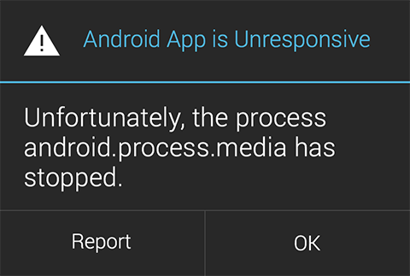
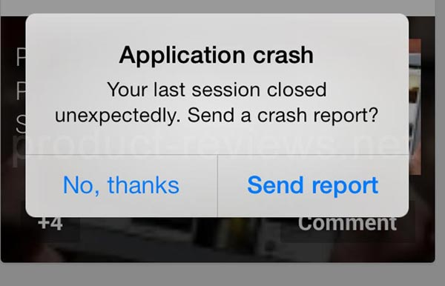

Slide 13
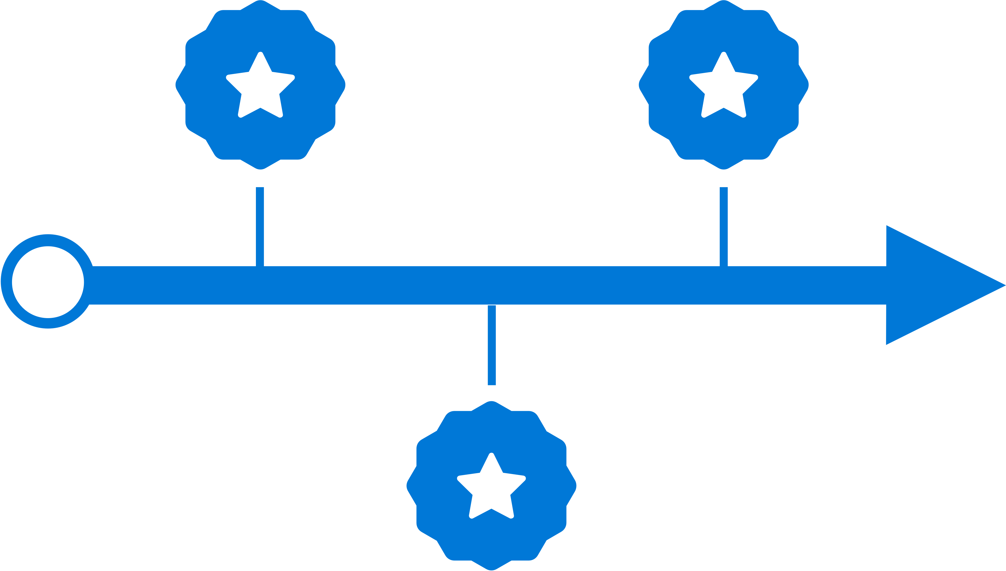
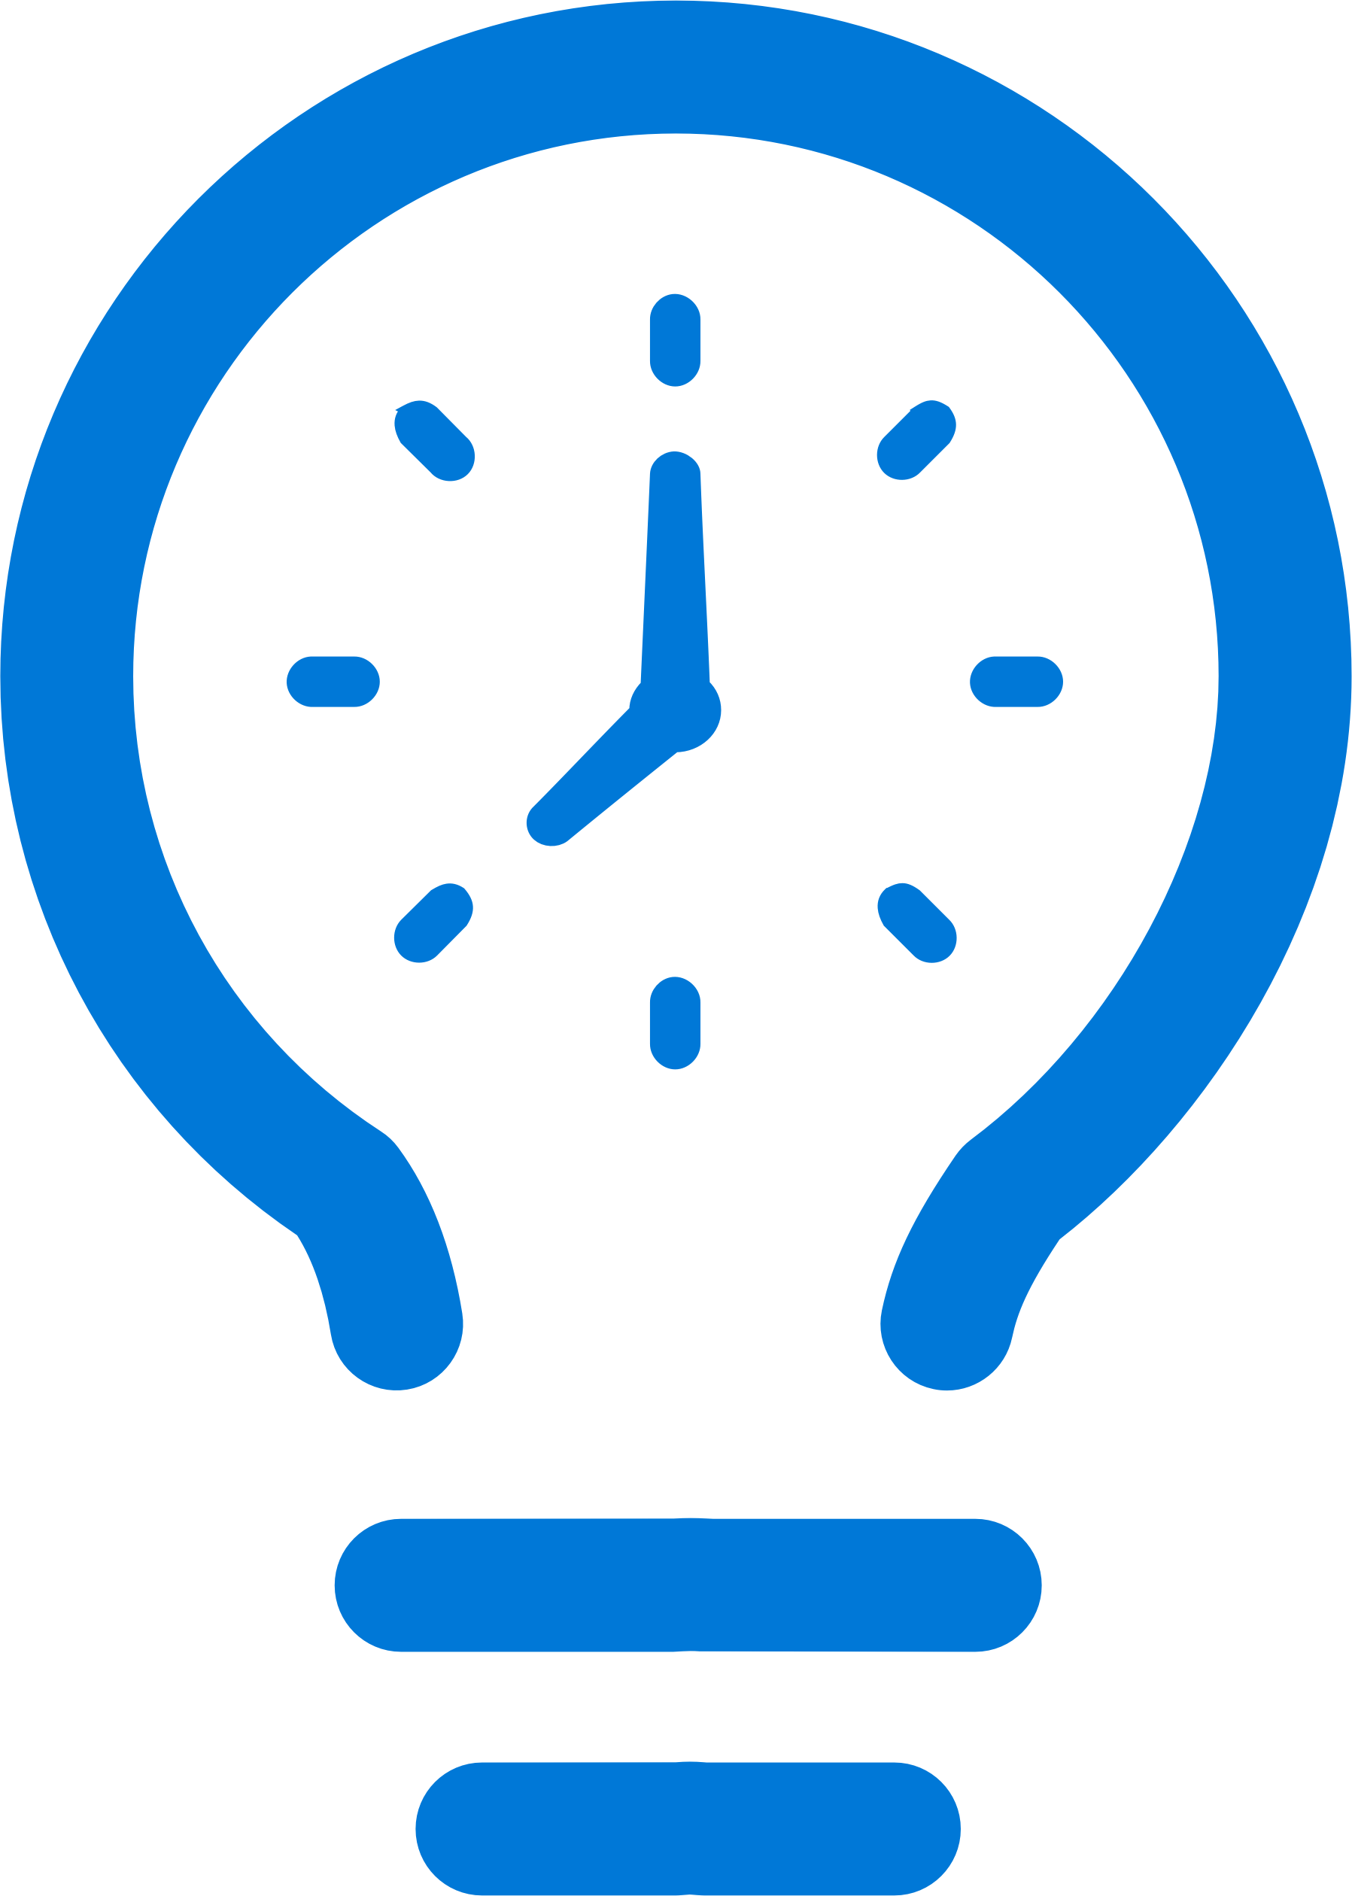
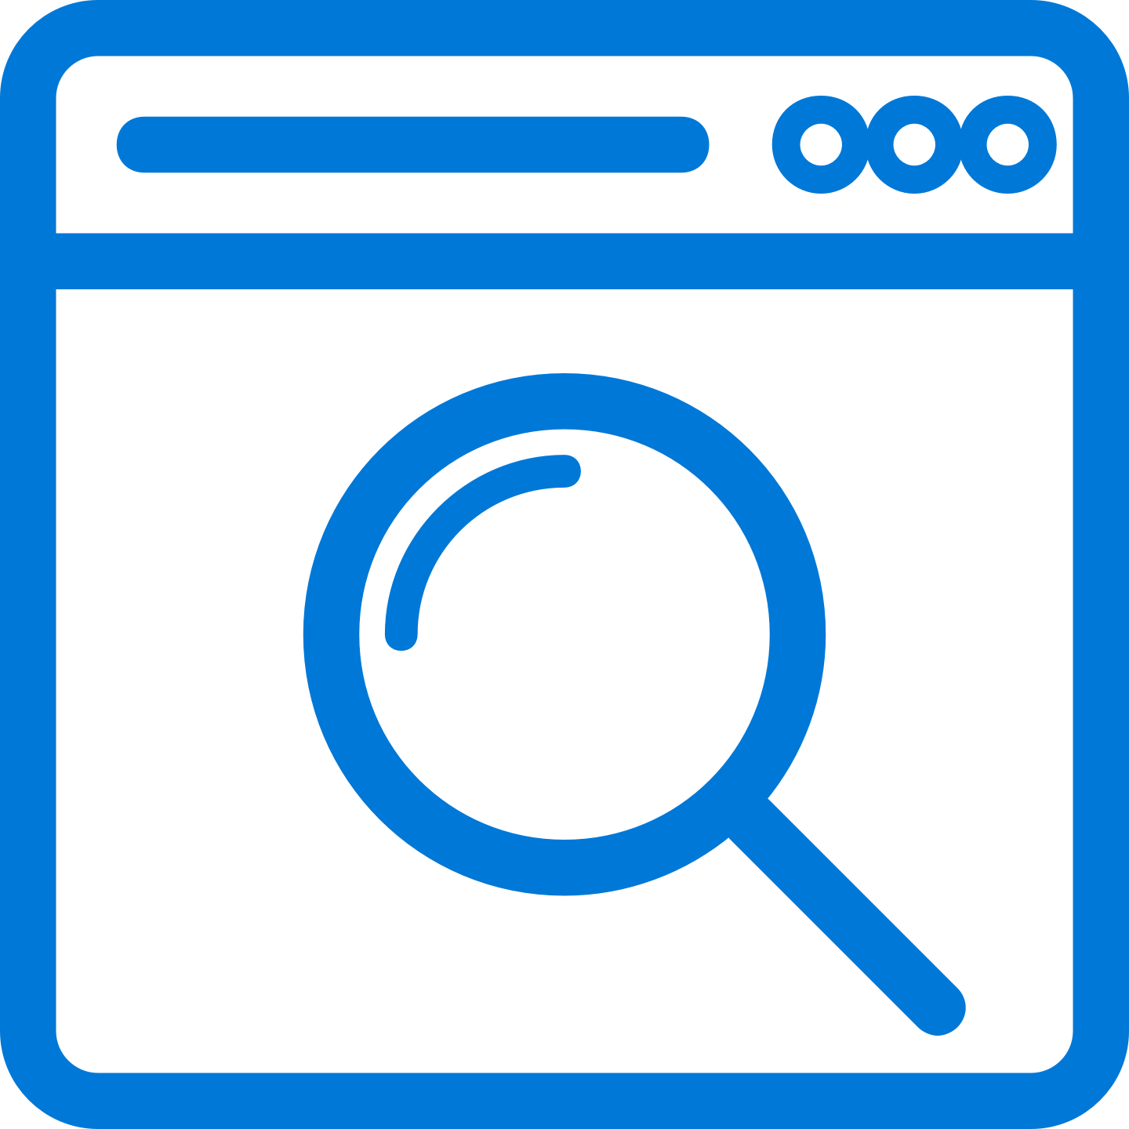
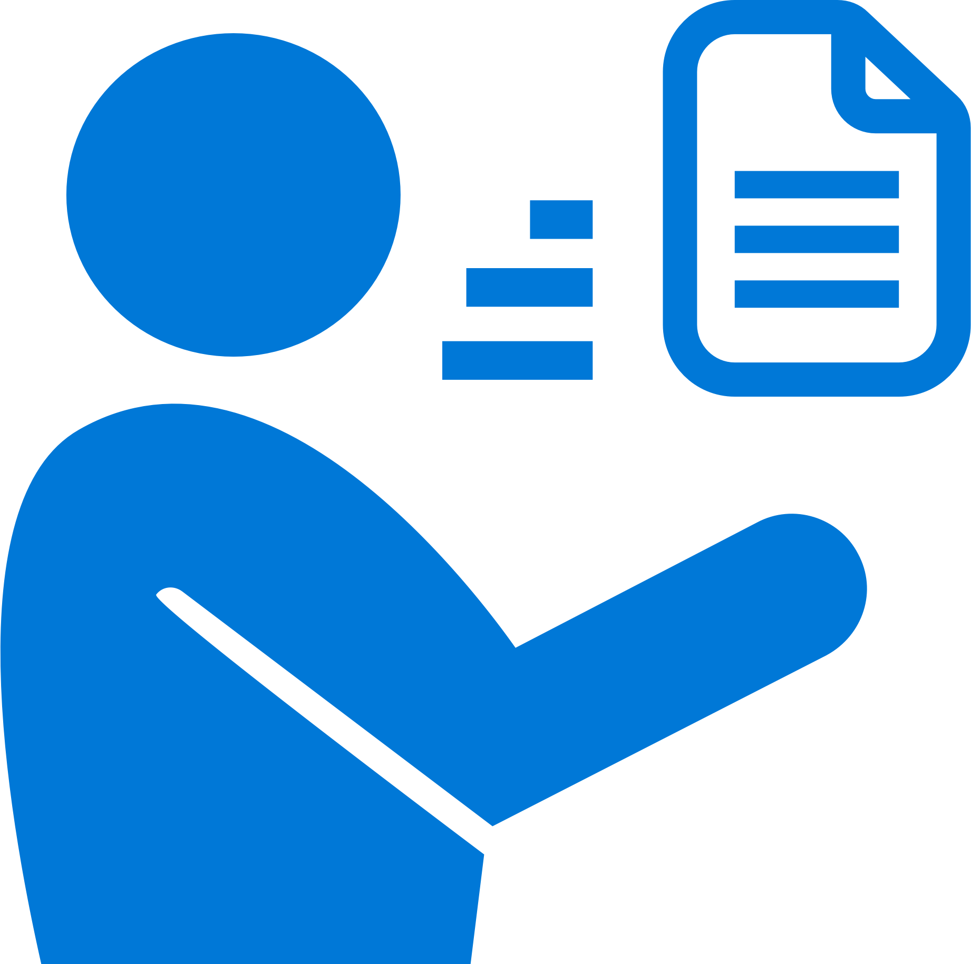
Mobile Center: Crashes
Ship consistent quality
Diagnose crashes fast for maximum uptime and maintain high quality
Get real-time insights
Monitor your app health with real-time crash reports to diagnose and fix problems quickly
Do smart troubleshooting
Crashes are grouped together by similarities to focus on the most critical groups
Easily analyze data
Get detailed, easy-to-read stack traces and logs to quickly understand issues

Slide 14
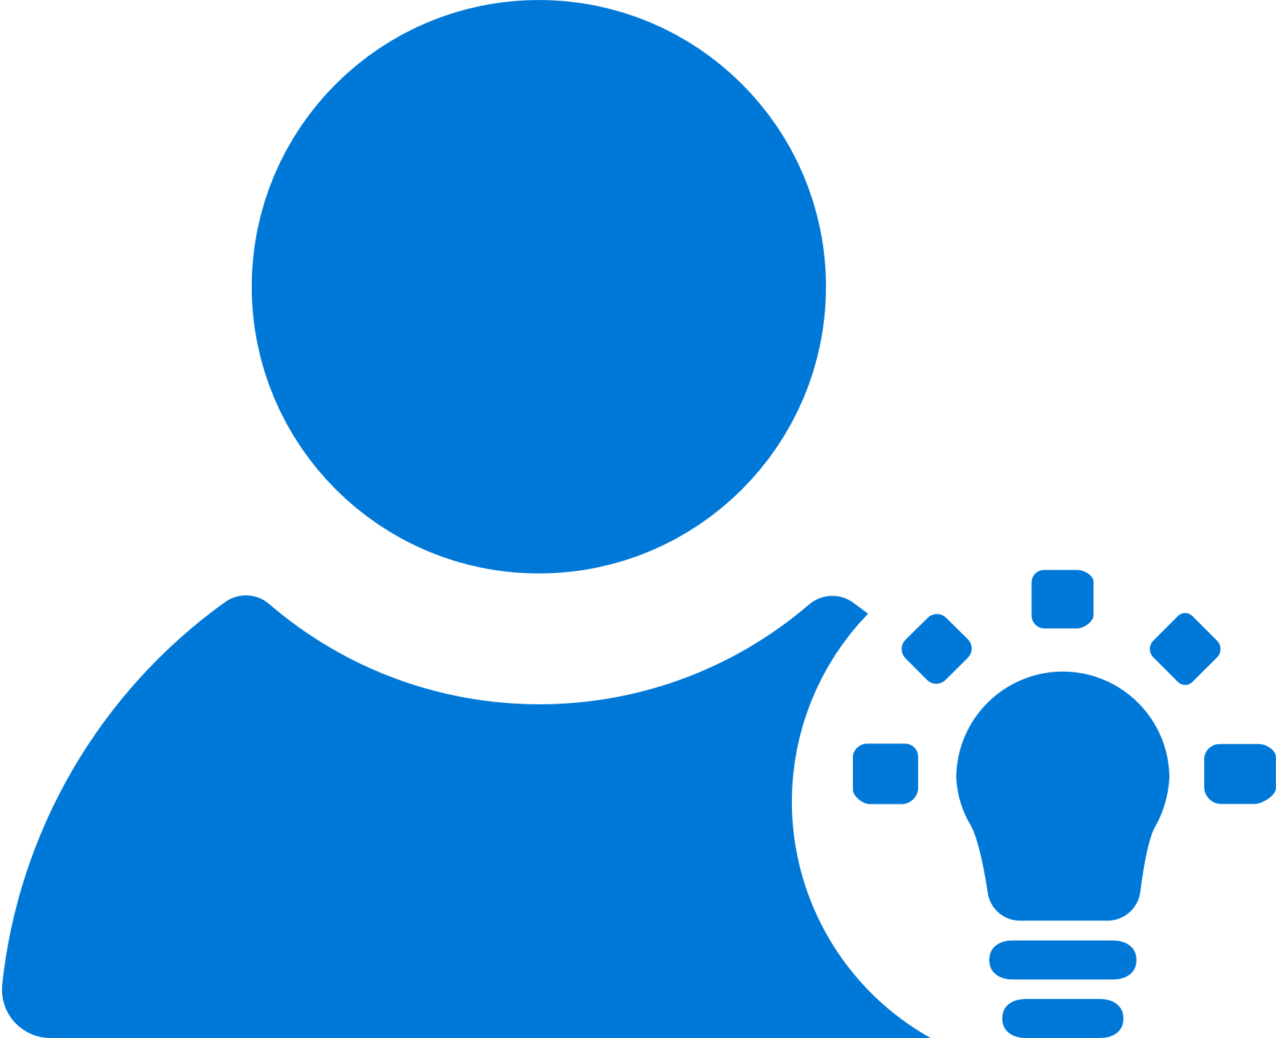
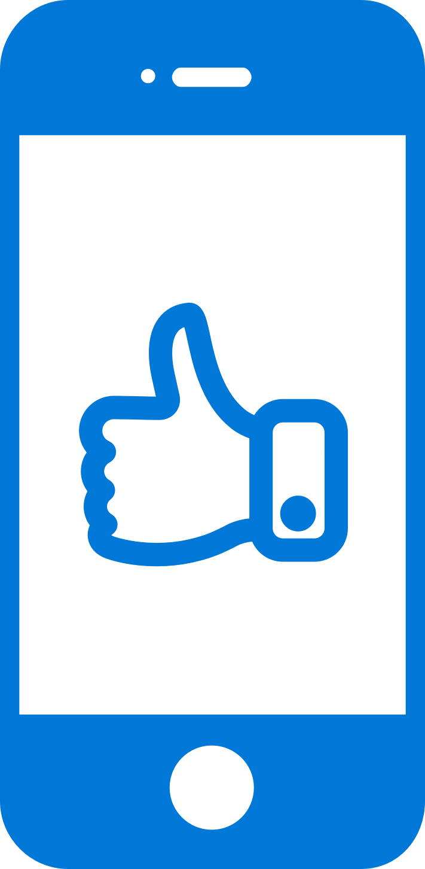


Mobile Center: Analytics
Access instant data
Integrate the analytics SDK in just two steps to start instantaneously seeing data from your app
Understand your customers
Real-time app usage data about your core audience—devices, locations, session info, and more
Build what users want
Analyze the data to see how customers use your app and accordingly prioritize and build new features
Learn more faster
Use custom events to follow users’ actions through your app to analyze their likes and dislikes

Slide 15
Key Features
Overview
Custom Events
Log Flow
Export to Azure

Slide 16
Sign up free today: mobile.azure.com

